Slide 1
PIF
Input from Netronome:
- IR Additions for P4
- Run-Time Interface Considerations

Slide 2
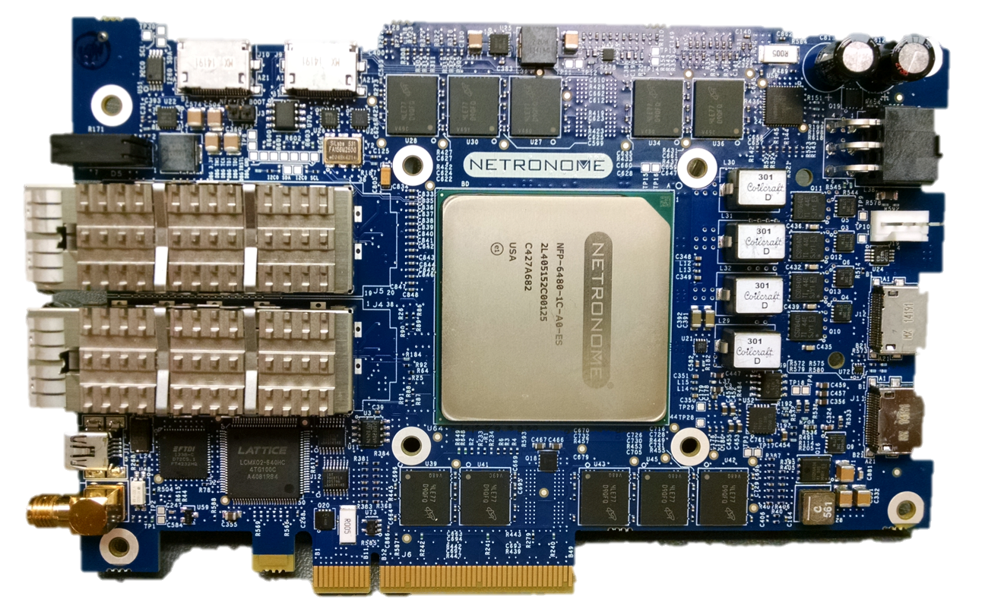
iNIC P4 + PIF IR Implementation:
Compilation + Development Environment
Parse - Match - Act
Dataplane Program
app.P4
Stateful / complex
packet processing code
Compile
plugin.C
P4 and C Integrated
Development
Environment
Edit - Build - Run
Intermediate Representation
ONF PIF => OpenSourceSDN.org
app.IR
=
Compile / Link
Debug
app.firmware
Native code
for NFP iNIC
Run-time interaction
Network

Slide 3
Goals + Approach
Compile to Netronome Network Flow Processor native code
Support both P4 high level language and OSSDN IR (AIR-IRI)
Leverage existing P4.org high level language compiler
Translate P4 “HLIR” (Python objects in memory) to AIR-IRI (objects in YAML file)
Alignment between HLIR and AIR-IRI
Some constructs align well e.g. header definitions, parsing, control flow
Added constructs not covered yet
Added mechanisms for IDE integration and run-time interface

Slide 4
IR Additions for Parsing
Setting metadata within parse node
Added “sets” key with array metadata refs
Value + Mask select values
Tagged transition with optional mask field: start -> parse_ethernet [value=0xdead, mask=0xffff]
Variable control flow entry point
Parser can 'jump' to any node in ingress/egress flow

Slide 5
IR Additions for Control Flow
Conditional transition based on field values/header valid _condition_0: type : conditional format : pyexpr condition : (ingress_metadata.ingress_bypass == 0x0)
In digraph _condition_0 -> exit_control_flow [condition = false]

Slide 6
IR Additions for Registers + Counters
Instantiation: cntr_direct: type : register class : global table : tbl_testval_0 instance_count : 4 fields : - value_bytes : 48 - value_packets : 32 counts : - bytes : value_bytes - packets : value_packets
Action: count(cntr_global.value_packets, 1); count_bytes(cntr_global.value_packets, 0); register_read(test_metadata.val32, cntr_global.value_packets) register_write(cntr_global.value_packets, 0)
Notes:
Registers and counters are declared in the same way
Counters have the addition 'counts' property

Slide 7
IR Additions for Digests (Events)
Instantiation: test_event_field_list: type : field_list fields : - ethernet.dstAddr - test_metadata.val0 - test_metadata.val1 test_event : type : digest identifier : 1 field_list : test_event_field_list
Action: generate_digest(test_event);

Slide 8
IR Additions for Header Stacks
Instantiation: vlan : type : header max_depth : 5 fields : - pcp : 3 - cfi : 1 - vid : 12 - etherType : 16
Action: remove_header(vlan[1]); pop(vlan, 2); remove_header(vlan[last]);
Control flow: valid(vlan[0]) vlan[1].vid vlan[last].vid

Slide 9
IR Additions for Development Environment
Source info section: date, revision strings, source files, output file name... source_info : type : source_info date : 2015-06-30 09:03:35 source_files : ...
Source filename and line number per object
Allows mapping AIR-IRI output to original P4 source

Slide 10
iNIC P4 + PIF IR Implementation: Run-Time Interaction
SDN
Controller
Toolchain
OpenFlow ++
VNF or L4-L7
or other app
app.firmware
Native code
for NFP iNIC
OpenFlow
Agent
Callable API
e.g. Thrift
API
Network
Generated CLI
vs API driven CLI
table_data.JSON
Debug API
Debug
table_info.JSON
Vendor specific
e.g. memory layout
Describe tables, action data
=> generated model (TTP )?

Slide 11
Run-time Interface Details
Workflow options
Create model (~ .h file), then write program (~ .c file) to conform
Create program, then extract interface (model, API…) from it
Generated items
Model
Consumed by tools, controller etc.
Negotiated too?
Interface
Example: “IDL” for Thrift => callable API (C, Python…)
Vendor/implementation specific debug info
Schema and encoding of items can be discussed
Prototype: model in purpose specific JSON format
Create Table Typing Pattern (TTP), or new instance of Negotiable Datapath Model (NDM)?

